Slide 1
MINI ‘BLOG’
DSA
Project Presentation
[MANAGEMENT SYSTEM]
< GROUP A >
<Manahil Habib
Nagarash Fateh
Leena Sadiqa
Laiba Jameel
Sana Arshad
Iman Arshad>
}
Project Presentation
DSA

Slide 2
MODULES
3/6
4/6
5/6
6/6
Project Presentation
User
1/6
2/6
Blog Post
Comment
Category
Search
feedback

Slide 3
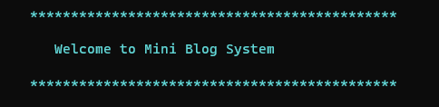
INTRODUCTION :-
MINI BLOG SYSTEM
DSA
Mini Blog Management System is a
comprehensive software project
designed to provide users with a platform for
Creating
Managing
Interacting
with blogs
}
DSA
MINI BLOG SYSTEM

Slide 4
MODULE 1: USER MODULE
USER
Project Presentation
Username
Password
Bio
< What is your name >
< Is your password strong >
< Tell abput yourself >
Project Presentation

Slide 5
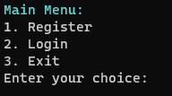
Main Menu
You cannot “Login” user without “Registration”

Slide 6
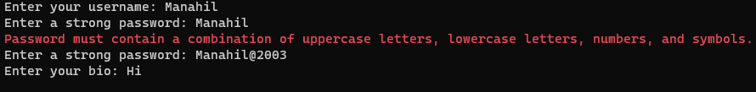

Register :
Is A Strong Function
Login:

